Slide 1
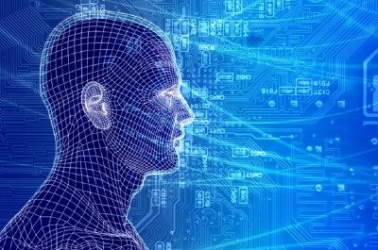
Machine Learning AND IT’S APPLICATIONS
101128629
CHANPREET SINGH ( School of Information Technology )

Slide 2
What is Learning?
“Learning is any process by which a system improves performance from experience.”
What is the task?
Classification
Categorization/clustering
Problem solving / planning / control
Prediction
others

Slide 3
So What Is Machine Learning?
A branch of artificial intelligence, concerned with the design and development of algorithms that allow computers to evolve behaviors based on empirical data.
As intelligence requires knowledge, it is necessary for the computers to acquire knowledge.
Automating automation
Getting computers to program themselves
Writing software is the bottleneck
Let the data do the work instead!

Slide 4
Role of Machine Learning?
Aspect of AI: creates knowledge
Definition:
“changes in a system that ... enable it to do the same task or tasks drawn from the same environment more efficiently and more effectively the next time.'’
There are two ways that a system can improve:
1. By acquiring new knowledge
acquiring new facts
acquiring new skills
2. By adapting its behavior
solving problems more accurately
solving problems more efficiently

Slide 5
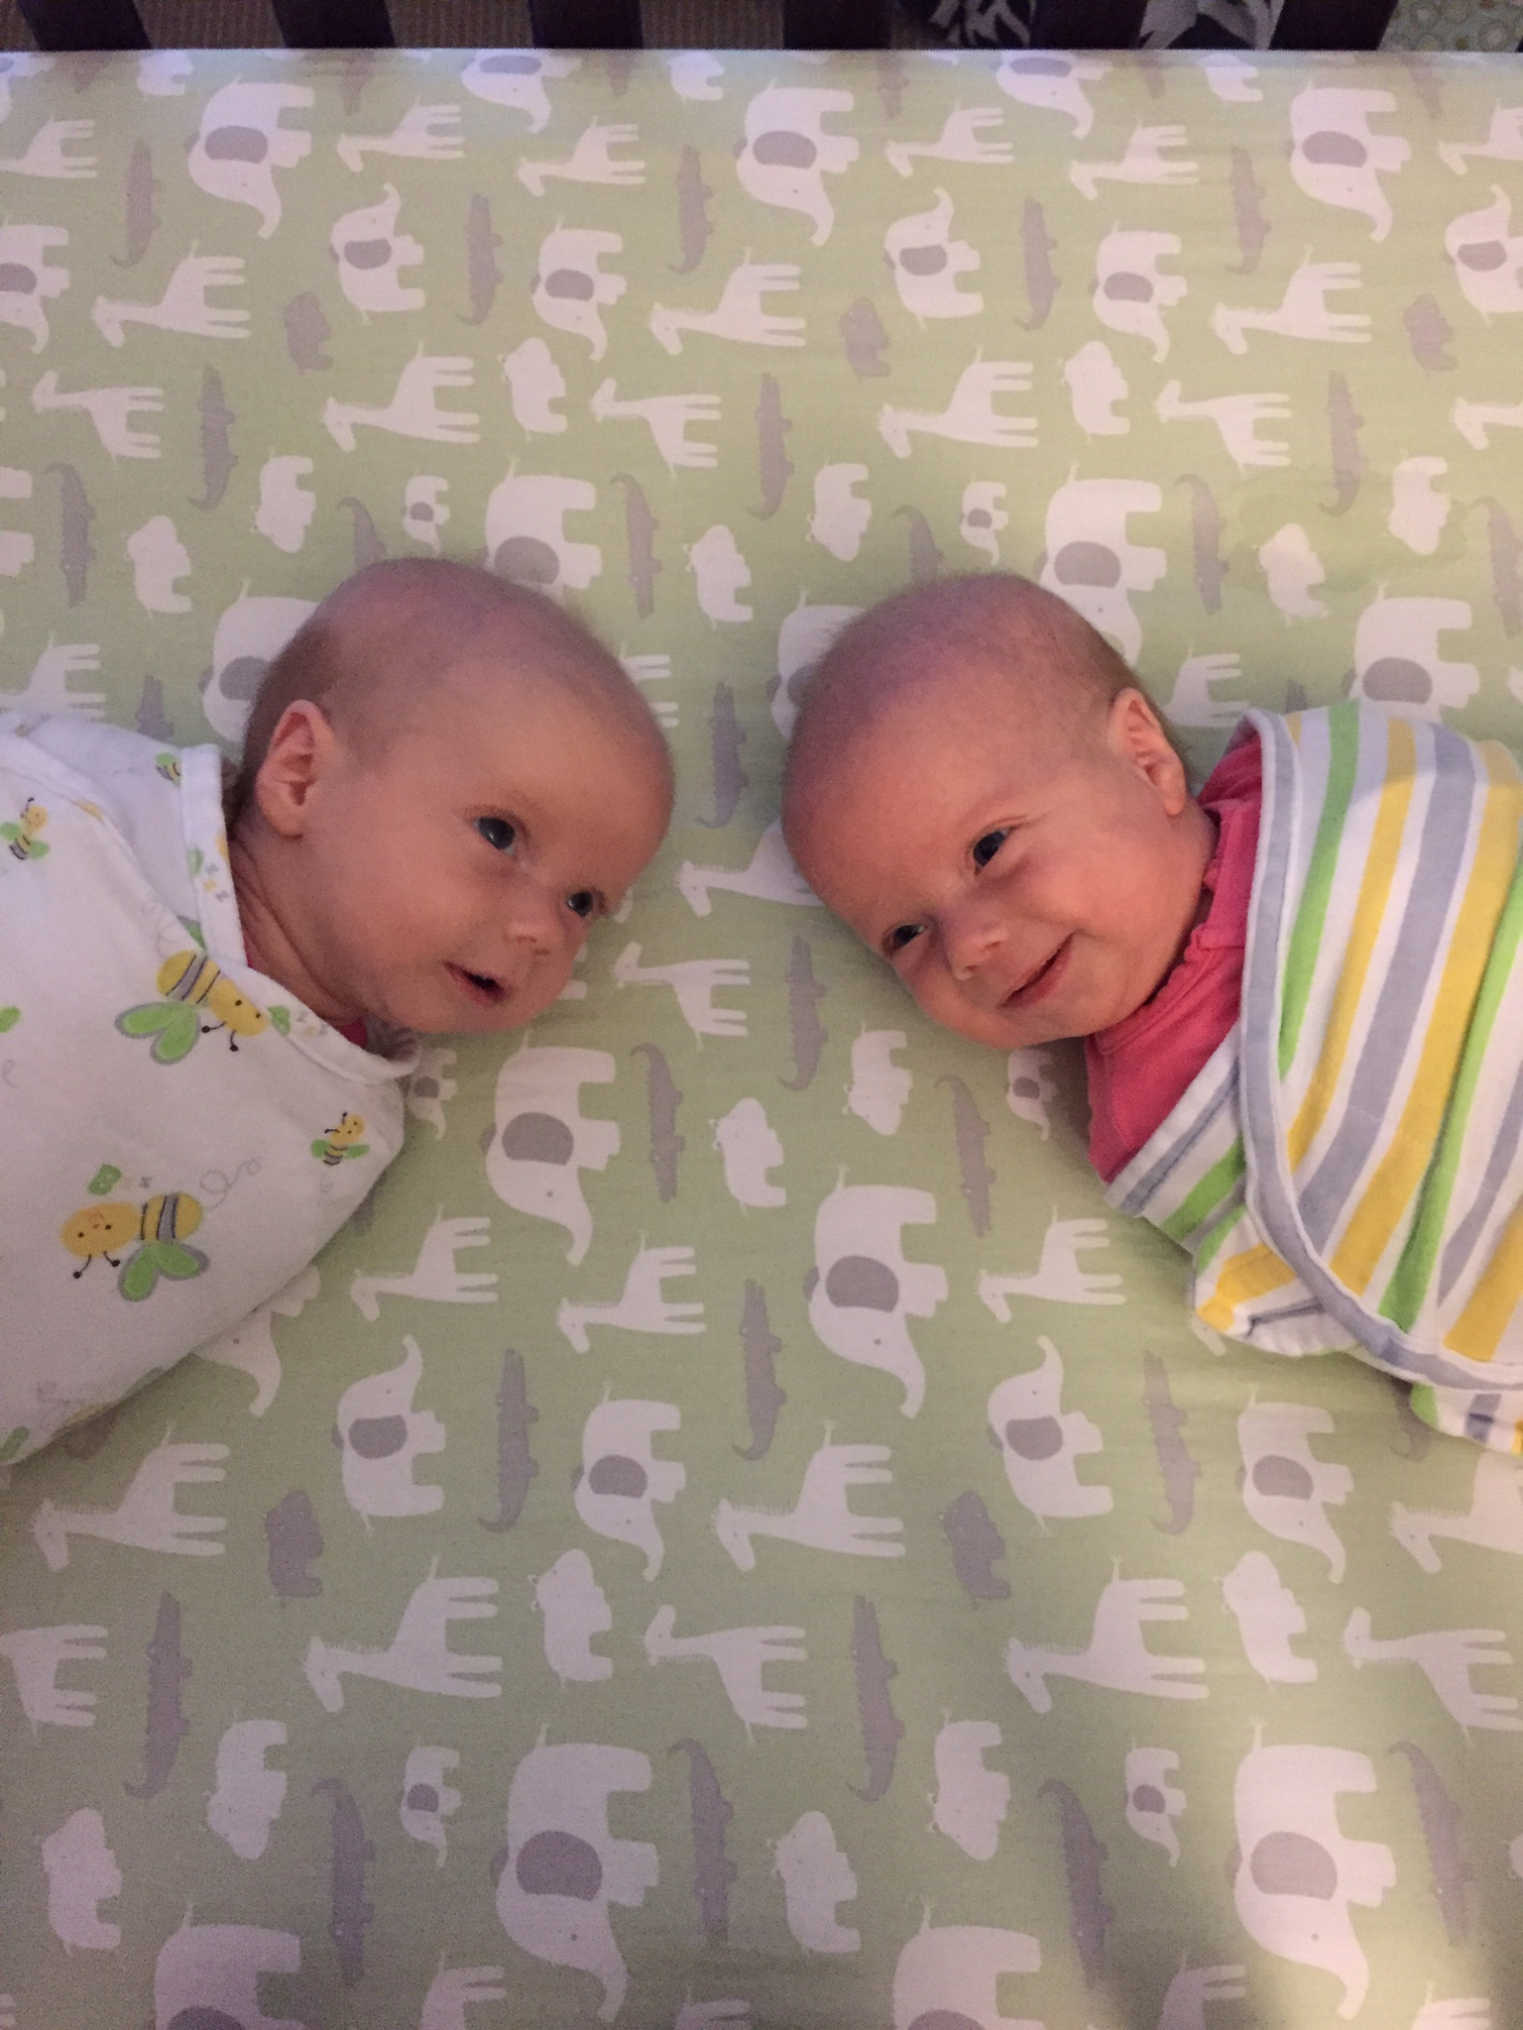

Why Machine Learning is Hard?
Your ML Algorithm Sees
A Bunch of Bits
You See

Slide 6
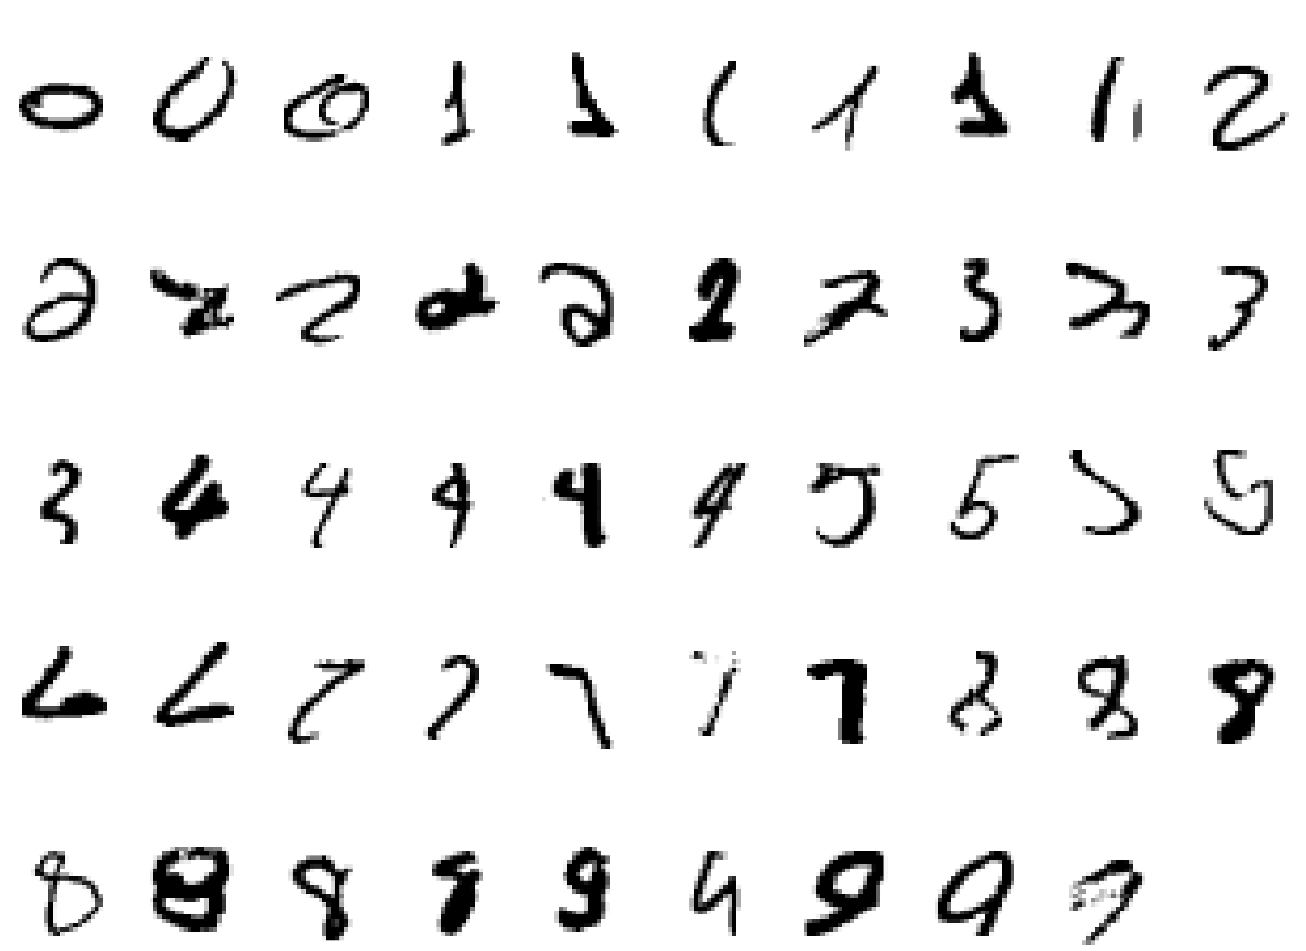
Why Machine Learning Is Hard, Redux What is a “2”?

Slide 7

Magic?
7
No, more like gardening
Seeds = Algorithms
Nutrients = Data
Gardener = You
Plants = Programs

Slide 8
The Same Thing Said in Cartoon Form
Traditional Programming
Machine Learning
Data
Computer
Output
Program
Data
Computer
Program
Output

Slide 9
ML in a Nutshell
Tens of thousands of machine learning algorithms
Hundreds new every year
Every machine learning algorithm has three components:
Representation
Evaluation
Optimization

Slide 10
Representation
Decision trees
Sets of rules / Logic programs
Instances
Graphical models
Neural networks
Support vector machines
Model ensembles
Etc.

Slide 11
Evaluation
Accuracy
Precision and recall
Squared error
Likelihood
Posterior probability
Cost / Utility
Margin
Entropy
K-L divergence
Etc.

Slide 12
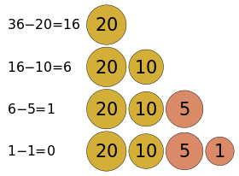
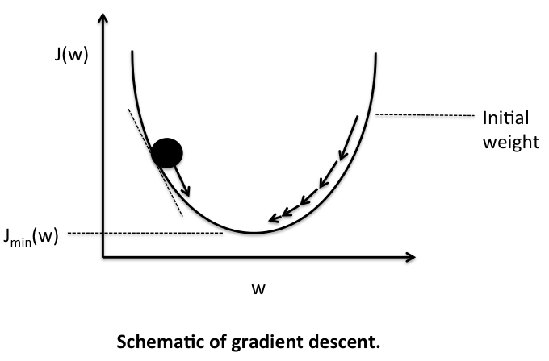
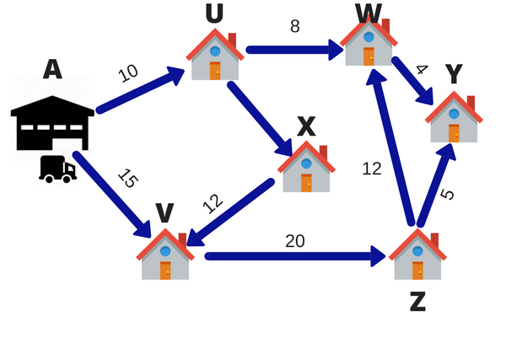
Optimization
Combinatorial optimization
E.g.: Greedy search
Convex optimization
E.g.: Gradient descent
Constrained optimization
E.g.: Linear programming

Slide 13
Learning system model
Testing
Input Samples
Learning Method
System
Training

Slide 14
Training and testing
Data acquisition
Practical usage
Universal set
(unobserved)
Training set (observed)
Testing set
(unobserved)

Slide 15
Training and testing
Training is the process of making the system able to learn.
No free lunch rule:
Training set and testing set come from the same distribution
Need to make some assumptions or bias

Slide 16
Types of Learning
Supervised learning: uses a series of labelled examples with direct feedback
Unsupervised/clustering learning: no feedback
Semi supervised : Uses both labelled and unlabelled data for training a classifier
Reinforcement learning: indirect feedback, after many examples
Rewards from sequence of actions
Decision making (robot, chess machine)

Slide 17
Algorithms
Supervised learning
Unsupervised learning
Semi-supervised learning

Slide 18
When Would We Use Machine Learning?
Pattern Recognition
Facial identities or facial expressions
Handwritten or spoken words (e.g., Siri)
Medical images
Sensor Data/IoT
Optimization
Many parameters have “hidden” relationships that can be the basis of optimization
Pattern Generation
Generating images or motion sequences
Anomaly Detection
Unusual patterns in the telemetry from physical and/or virtual plants (e.g., data centers)
Unusual sequences of credit card transactions
Unusual patterns of sensor data from a nuclear power plant
or unusual sound in your car engine or …
Prediction
Future stock prices or currency exchange rates
Network events

Slide 19
Which of these things is NOT like the others?

Slide 20
Which of these things is like the others? And how?

Slide 21
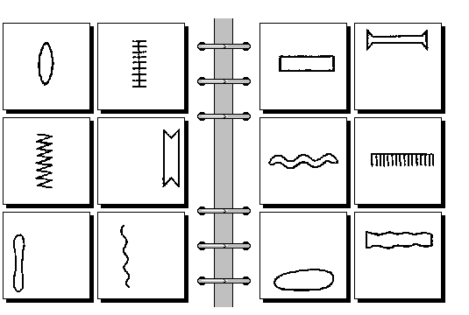
Bongard problems
visual pattern rule induction
CONVEX SETS VS CONCAVE SETS

Slide 22
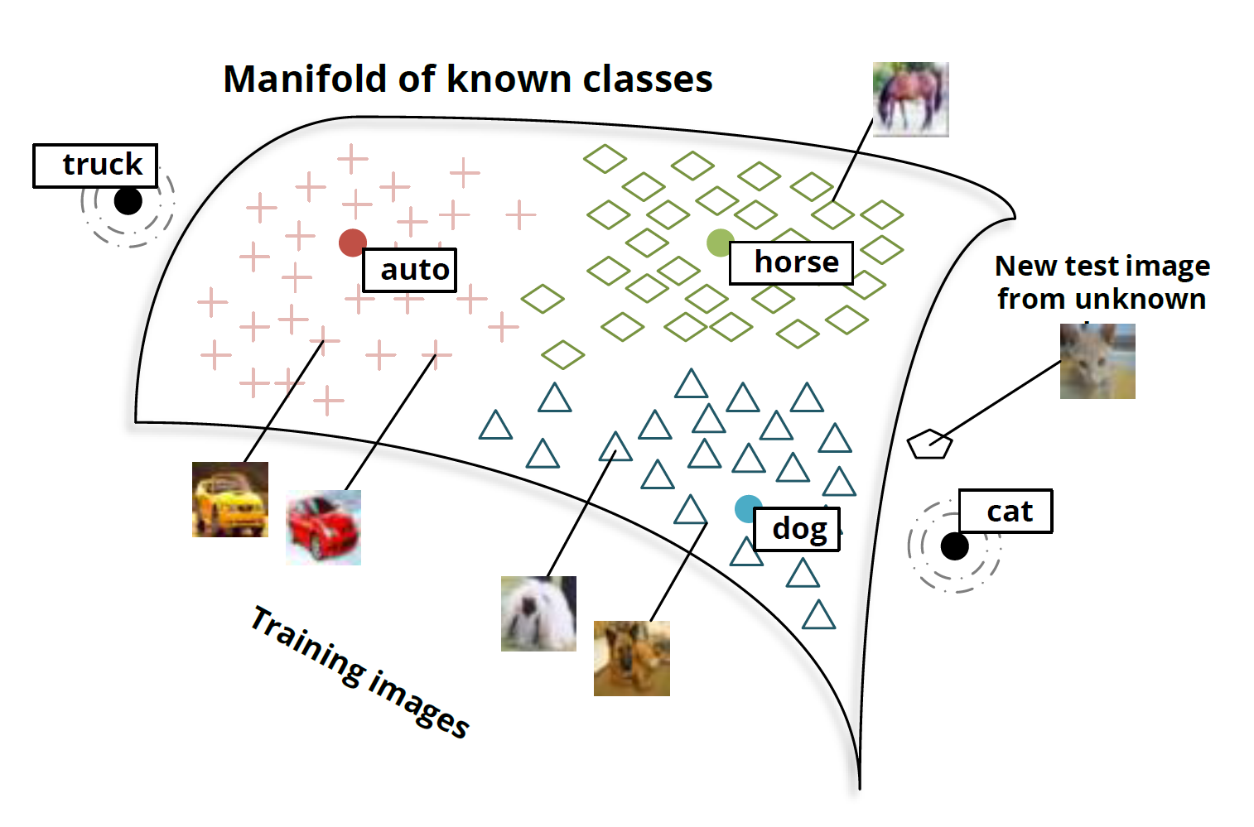
Another View: Manifolds and Classes

Slide 23

Robotics and ML
Areas that robots are used:
Industrial robots
Military, government and space robots
Service robots for home, healthcare, laboratory
Why are robots used?
Dangerous tasks or in hazardous environments
Repetitive tasks
High precision tasks or those requiring high quality
Labor savings
Control technologies:
Autonomous (self-controlled), tele-operated (remote control)

Slide 24
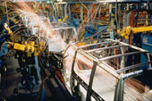
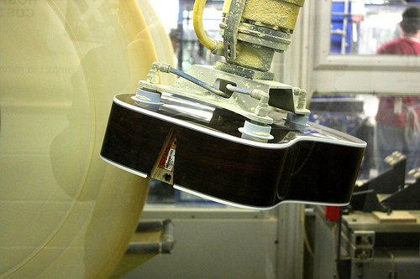
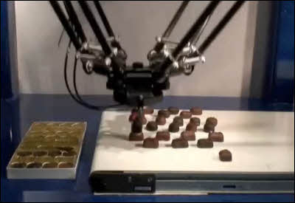
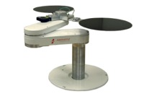
Industrial Robots
Uses for robots in manufacturing:
Welding
Painting
Cutting
Dispensing
Assembly
Polishing/Finishing
Material Handling
Packaging, Palletizing
Machine loading

Slide 25
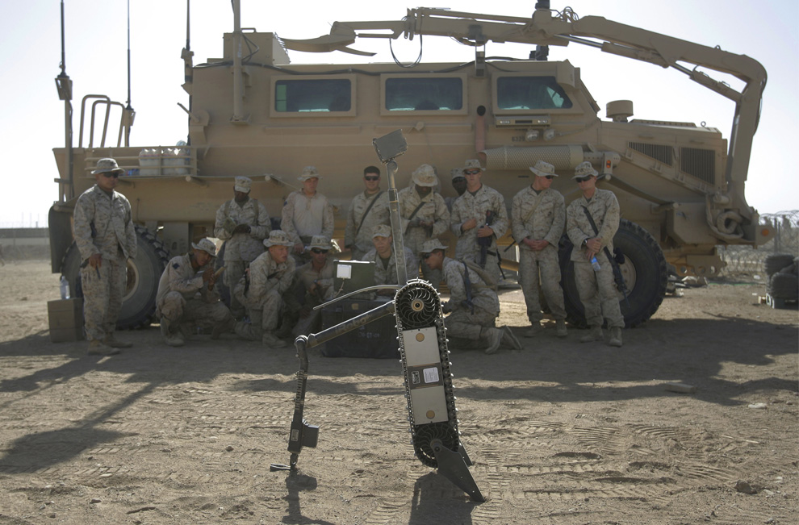
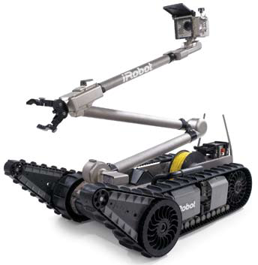
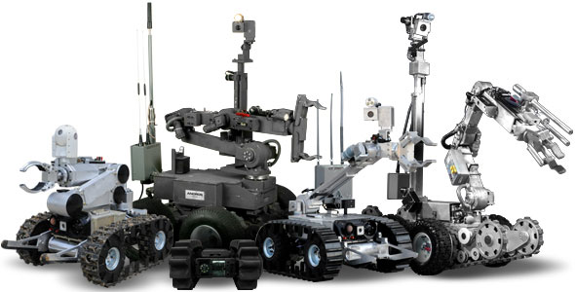
Military/Government Robots
iRobot PackBot
Remotec Andros
Soldiers in Afghanistan being trained how to defuse a landmine using a PackBot.

Slide 26
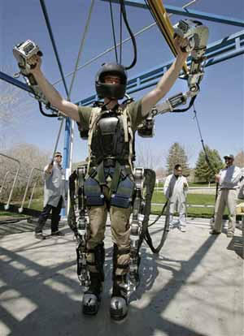
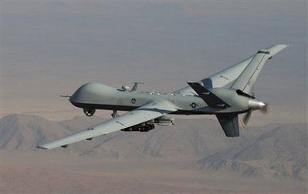
Military Robots
Aerial drones (UAV)
Military suit

Slide 27
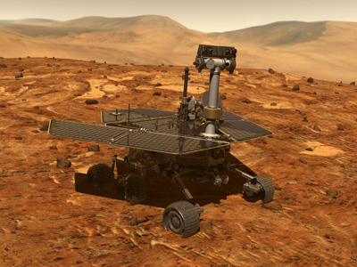
Space Robots
Mars Rovers – Spirit and Opportunity
Autonomous navigation features with human remote control and oversight

Slide 28
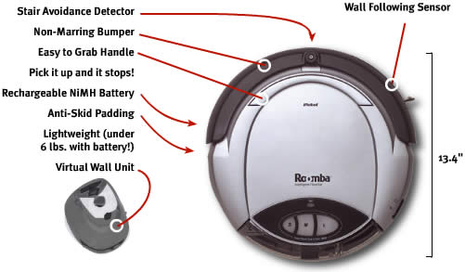
Service Robots
Many uses…
Cleaning & Housekeeping
Humanitarian Demining
Rehabilitation
Inspection
Agriculture & Harvesting
Lawn Mowers
Surveillance
Mining Applications
Construction
Automatic Refilling
Fire Fighters
Search & Rescue
iRobot Roomba vacuum cleaner robot

Slide 29
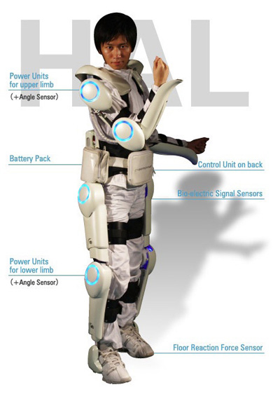
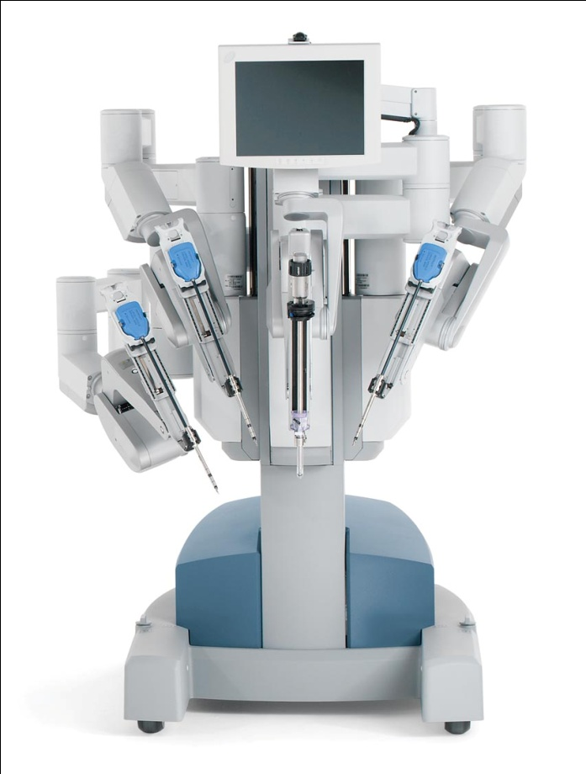
Medical/Healthcare Applications
DaVinci surgical robot by Intuitive Surgical.
St. Elizabeth Hospital is one of the local hospitals using this robot. You can see this robot in person during an open house (website).
Japanese health care assistant suit (HAL - Hybrid Assistive Limb)
Also… Mind-controlled wheelchair using NI LabVIEW

Slide 30
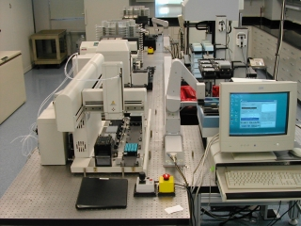
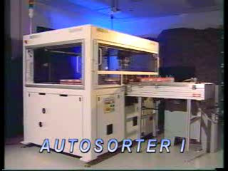
Laboratory Applications
Drug discovery
Test tube sorting

Slide 31
ALVINN
Autonomous Land Vehicle In a Neural Network
Drives 70 mph on a public highway
Predecessor of the Google car
Camera
image
30 outputs
for steering
30x32 weights
into one out of
four hidden
unit
4 hidden
units
30x32 pixels
as inputs

Slide 32
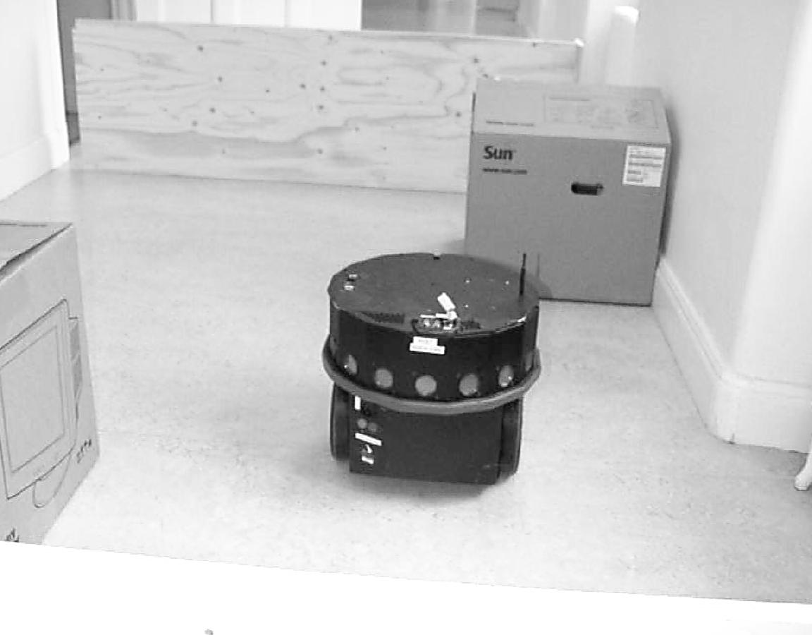
Scout Robots
16 Sonar sensors
Laser range
scanner
Odometry
Differential drive
Simulator
API in C

Slide 33
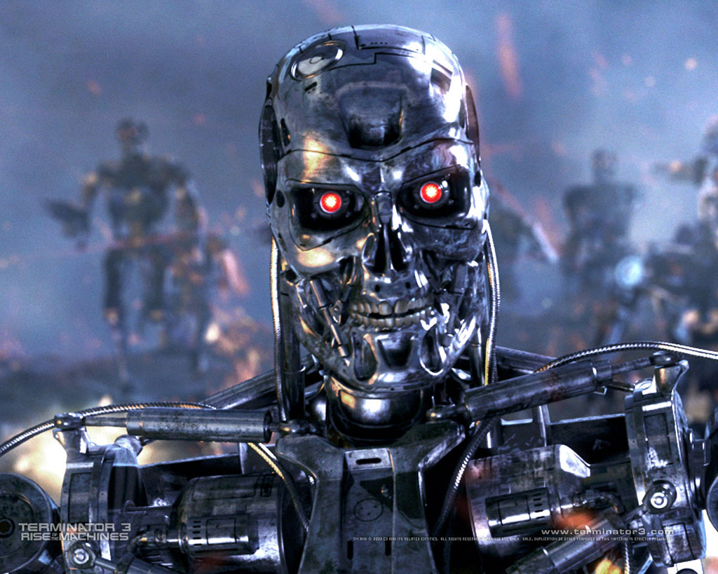
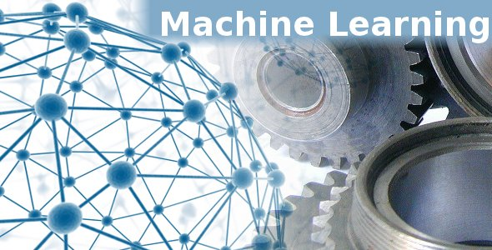
Where I Want To Go With This
This
Not This
What Might an Architecture for this Look Like?

Slide 34






Software Defined Intelligence
Architecture Overview
Domain Knowledge
Domain Knowledge
Domain Knowledge
Domain Knowledge
Brocade and 3rd party Applications
Analytics Platform
Learning
Presentation Layer
Intelligence
Data Collection
Packet brokers, flow data, …
Preprocessing
Big Data, Hadoop, Data Science, …
Model Generation
Machine Learning
Oracle
Model(s)
Remediation/Optimization/…
Oracle
Logic
Oracle Logic Example (PCRF pseudo-code)
If (predict(User, X, eMBS)):
switch2eMBS(User)
Where X = (Mobility patterns, cell size, data plan,
weighted popularity of content, # of channels, …)
Topology, Anomaly Detection,
Root Cause Analysis,
Predictive Insight, ….

Slide 35
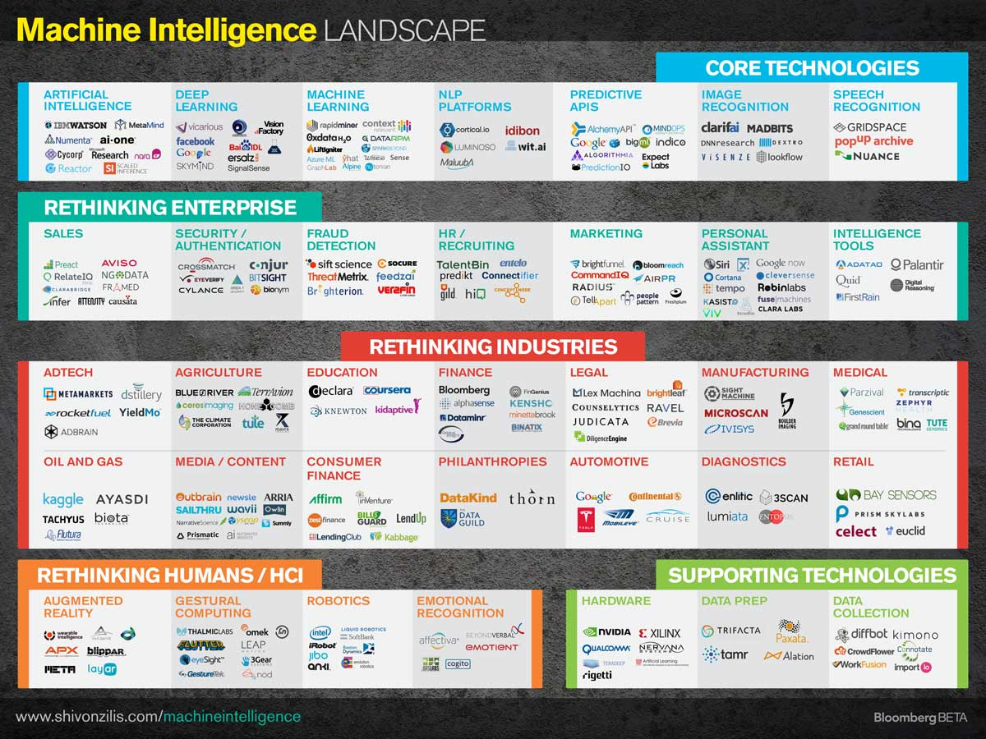

Slide 36
Q & A
Thanks!

